Slide 1
How a behavioral analysis of your last survey can help inform priorities for your next one
17th Transportation Planning Applications Conference
Session D4
Stacey Bricka and Becky Knudson

Slide 2
Overview
Background
Report Goals
Design “Flags”
Recommendations

Slide 3
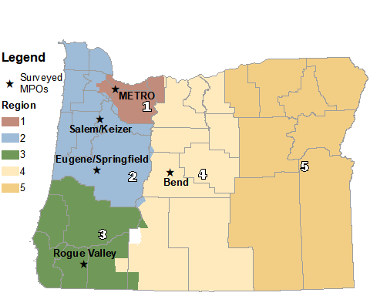
Project Background
Oregon Household Activity Survey (OHAS)
Joint effort for ODOT and five MPO partners
Designed in 2008
Data collection 2009-2011
(N=17,971 HH surveyed)
“Core” survey design resulted in common database across all surveys

Slide 4
Project Background
Survey Region | N | Survey Seasons
ODOT Region 2 | 3,577 | Spr & Fall 2009
ODOT Region 3 | 1,951 | Spring 2009
ODOT Region 4 | 1,210 | Spring 2009
ODOT Region 5 | 1,220 | Spring 2010
ODOT Region 1/Portland | 4,516 | Spr & Fall 2011
Central Lane | 1,786 | Fall 2009
Salem/Keizer | 1,821 | Spring 2010
Medford/Rogue Valley | 1,061 | Fall 2011
Bend | 799 | Spring 2011
Statewide Total | 17,941
OHAS deliverable: individual final report for each region
Documented methods, response rates, completeness of data
Same content across all regions (one report template)
Written for technical audience
Partners starting to plan for 2020-ish survey effort
Seeking funding
Identifying sample/data needs
This project: statewide report for non-technical audience

Slide 5
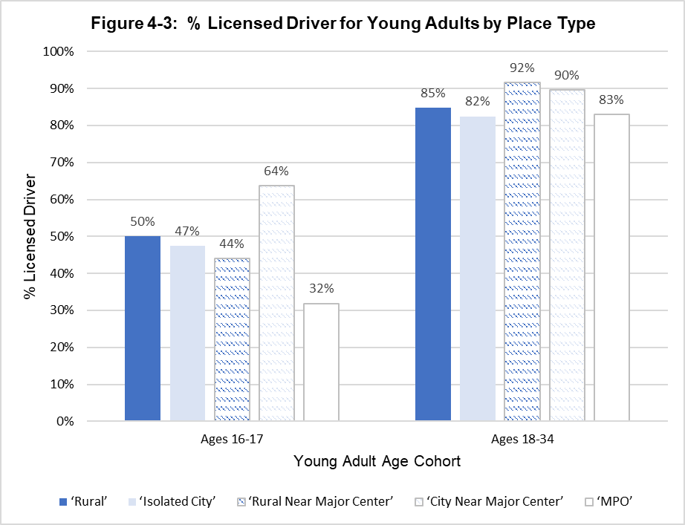
Report Goals
Structure
Report to tell a story (who, what, where, when and how of travel)
Ground rules
Audience = policy-makers and non-technical stakeholders
Technical documentation = replicability and QC
Investigate outliers = sample size and processing/QC issues
Content priority: answer key questions and explore common myths from policy perspective

Slide 6
oversight committee
Mix of technical and non-technical staff
Technical = separate documentation, key definitions in call-out boxes/footnotes
Non- technical = “right” level of detail for audience + visualization, clarify technical jargon
Mix of needs leads to identification of design “flags”
Interaction Effects
Mix of experience with OHAS

Slide 7
Design “Flags” IDENTIFIED
Sampling Frame
Residential ABS limits story (excludes group quarters - military, university, elderly, etc.)
Sampling
Goals need to consider demographics, geography AND behavior
Temporal
Typical weekday travel data cannot answer questions about multi-day, seasonality, weekend, or holiday travel.

Slide 8
Design “Flags” (CONT’D)
SAMPLING
Demographics
Geography
Behavior
Demographics: Workers
White vs. blue collar
Shift workers, service industry
Non-standard employees
Geography
Place type
Behavior
Non-auto travel
Inter-regional travel
Emerging trends
Policy questions

Slide 9
RECOMMENDATION – interaction effects
Behavioral report
Showcases value of data
Provides common foundation for stakeholders to discuss next survey design
Identifies design “flags”
Oversight committee
Ensures content written for non-technical audience
Clarifies differences in perspective as well as language
Design “Flags”
Sample size limitations
Questions unable to answer (in whole or in part)
Behavioral limitations
Interaction identifies design “flags”

Slide 10
Recommendations – Design “Flags”
Sampling
Targeted oversampling (informed by Census Data)
Social media outreach/ads
May need a separate supplemental survey or incorporate secondary data
Data Elements
Respondent burden and cost are primary concern
Key sub-groups: details + universe (income, worker type, low incidence mode users)
Looking forward
Blurred line between personal and commercial travel
“Softer” statistics (equality between probability and non-probability samples)
Data fusion between survey and passive data

Slide 11
Thank you!
CONTACT US:
Stacey Bricka sgbricka@gmail.com
Becky Knudson Rebecca.a.knudson@dot.or.state.us

